Slide 1

Stock Prediction
Tanmay Poyekar (20104053)
Sahil Vishwakarma (20104089)
Jai Rao (20104097)
Project Guide
Ms. Sonal Jain

Slide 2
Contents
Introduction
Objectives
Scope
Literature Survey
Proposed System
Project Outcomes
Block Diagram
Use Case/DFD
Technology Stack
Suggestions in Review-1
Result and Discussion
Conclusion and Future Scope
References

Slide 3
1. Introduction
Due to the high profit of the stock market, it is one of the most popular investments. People investigate for methods and tools that would increase their gains while minimizing the risk, as the level of trading and investing grew.
Problem Identified :
    Investors are familiar with the saying, “buy low, sell high” but this does not provide enough context to make proper investment decisions.
    Since the prices in the stock market are dynamic, the stock market prediction is complicated.

Slide 4
1. Introduction
Solution Proposed :
    The recent trend in stock market prediction technologies is the use of machine learning which makes predictions based on the values of current stock market indices by training on their previous values.

Slide 5
2. Objectives
To predict the stock prices in order to make more informed and accurate investment decisions.
To predict the stock price such that investors can sell it before its value decline, or buy the stock before the price rises.
To study and improve the supervised learning algorithms to predict the stock price.
To build a model that can accurately forecast the future price of a stock based on real-time data.

Slide 6
3. Scope
Stock traders can use stock price prediction models to make better investment decisions and optimize their portfolios.
Researchers can use stock prediction models to study the behavior of the stock market and to investigate the impact of various events and factors on stock prices.
Can be applied in various areas where accurate predictions of stock prices are critical for decision making.
Individuals can use stock prediction models to plan their financial investments.

Slide 7
4. Literature Survey
Sr.no | Title | Author(s) | Year | Algorithms | Limitations | Result
1 | Deep Learning for Stock Market Prediction | M. Nabipour, P. Nayyeri, H. Jabani | 2020 | Tree-Based Models, Artificial Neural Networks, RNN, LSTM | This paper concentrates on the future prediction of stock market groups. Four groups named diversified financials, petroleum, non-metallic minerals, and basic metals from Tehran stock exchange were chosen for experimental evaluations. | Six tree-based models namely Decision Tree, Bagging, Random Forest, Adaboost, Gradient Boosting, and XGBoost, and also three neural networks-based algorithms are employed in the prediction
2 | Applications of deep Learning in Stock Market Prediction | Weiwei Jiang | 2021 | Deep learning models, ARIMA. | Fundamental analysis evaluates the stock price based on its fair value, while technical analysis only relies on the basis of charts and trends. Afterwards, linear models are introduced as the solutions for stock market prediction. | Given different combinations of data sources, previous studies explored the use of deep learning models to predict stock market price.

Slide 8
4. Literature Survey
Sr.no | Title | Author(s) | Year | Algorithms | Limitations | Result
3 | Stock Closing Price Prediction Using Machine Learning Techniques | Mehar Vijh, Deeksha Chandola, Vinay Anand Tikkiwal, Arun Kumar | 2020 | ANN is used for predicting the next day closing price of the stock and for a comparative analysis, RF is also implemented | Predicting stock market returns is a challenging task due to consistently changing stock values which are dependent on multiple parameters. | To evaluate the effectiveness of the models, a comparison is made between the two techniques on five different sector companies using both ANN and RF models.

Slide 9
5. Proposed System
Visualization :
    The system provides various visualization , such as charts and graphs, to display the predicted stock prices and other relevant information.
Real-Time Stock Price Prediction :
The system can predict real-time stock prices using the trained machine learning models.
3. The system can forecasts stock prices of the next n days for a given stock with the help of given data and other relevant factors.

Slide 10
6.Outcome of Project
Improved User Experience by providing user-friendly interface for investors to interact with the system.
A successful ML program can make predictions in real-time, which can help investors make quick decisions about buying and selling stocks.
User can increase the efficiency of the investment process and help investors respond quickly to changes in the market.

Slide 11
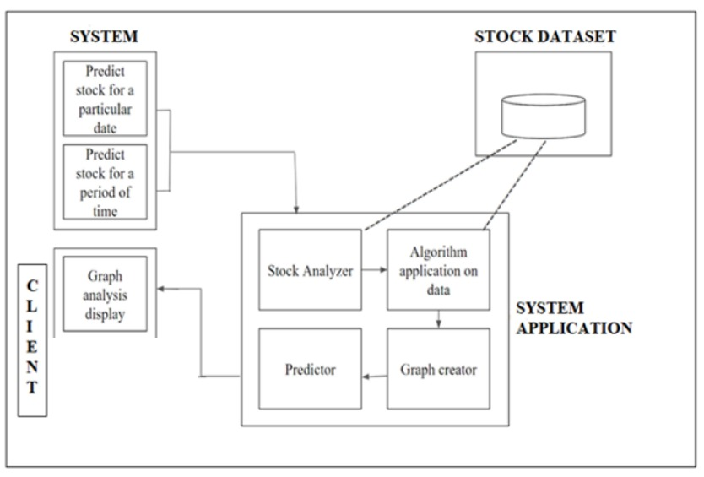
7. Block Diagram

Slide 12
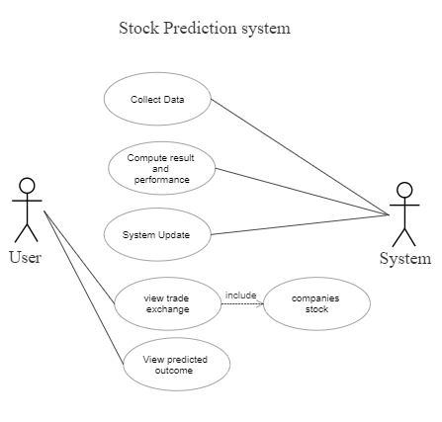
8. Use Case Diagram

Slide 13
9. Technology Stack
Languages: HTML5, CSS3, JAVASCRIPT, PYTHON
Framework: Bootstrap, Django
ML/DL: NUMPY, PANDAS, SCIKIT-LEARN
API used for: Yahoo Finance API.
IDE: VISUAL STUDIO CODE, PYCHARM

Slide 14
Suggestions in Review-1
To make sure that the system is working while predicting the stock price based on the given data by using the algorithm that will generate accurate predictions for future stock prices and help users identify market trends and opportunities.
The user interface will be designed to be intuitive and easy to use, making it accessible to a wide range of users, regardless of their technical background.

Slide 15
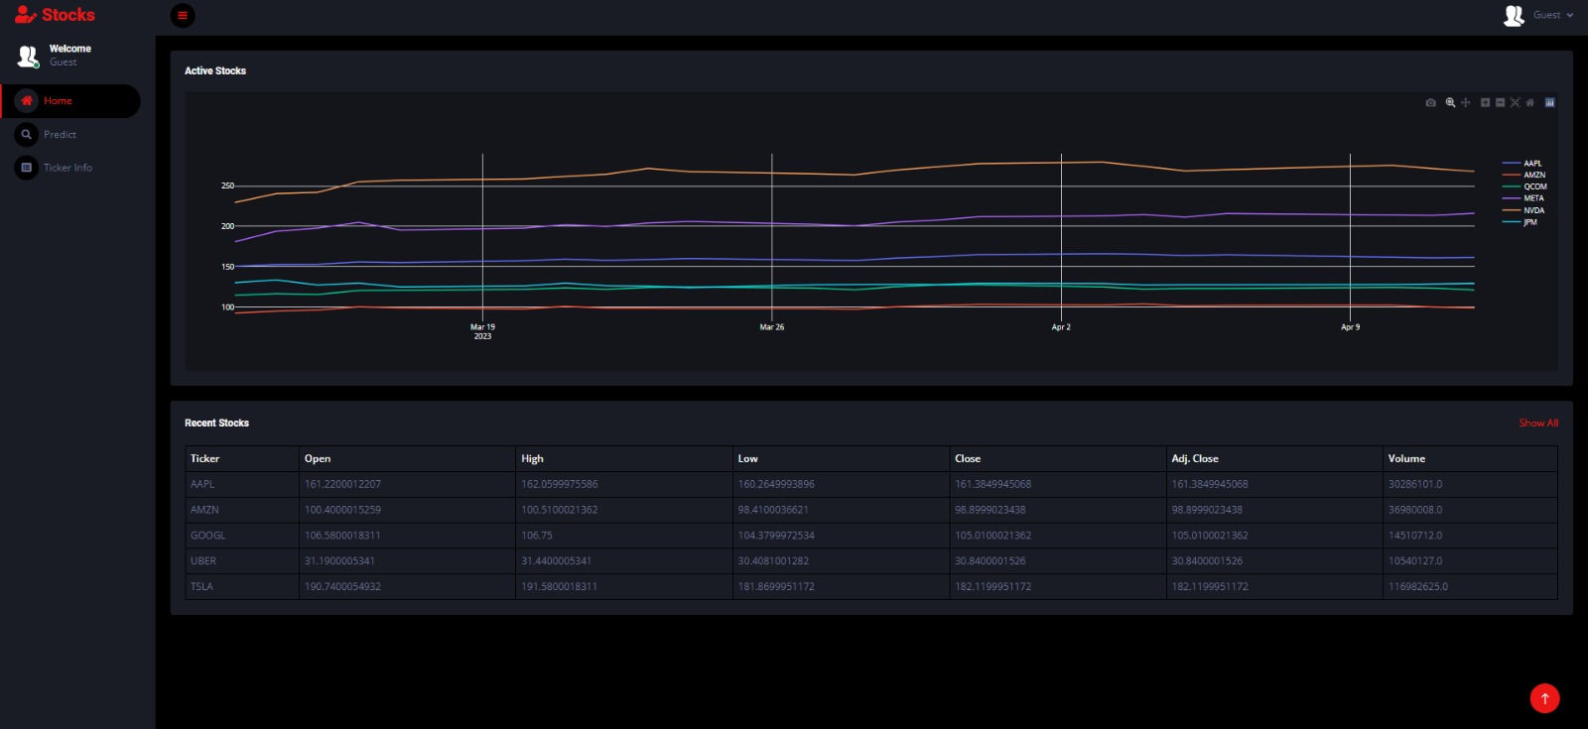

Result and Discussion

Slide 16
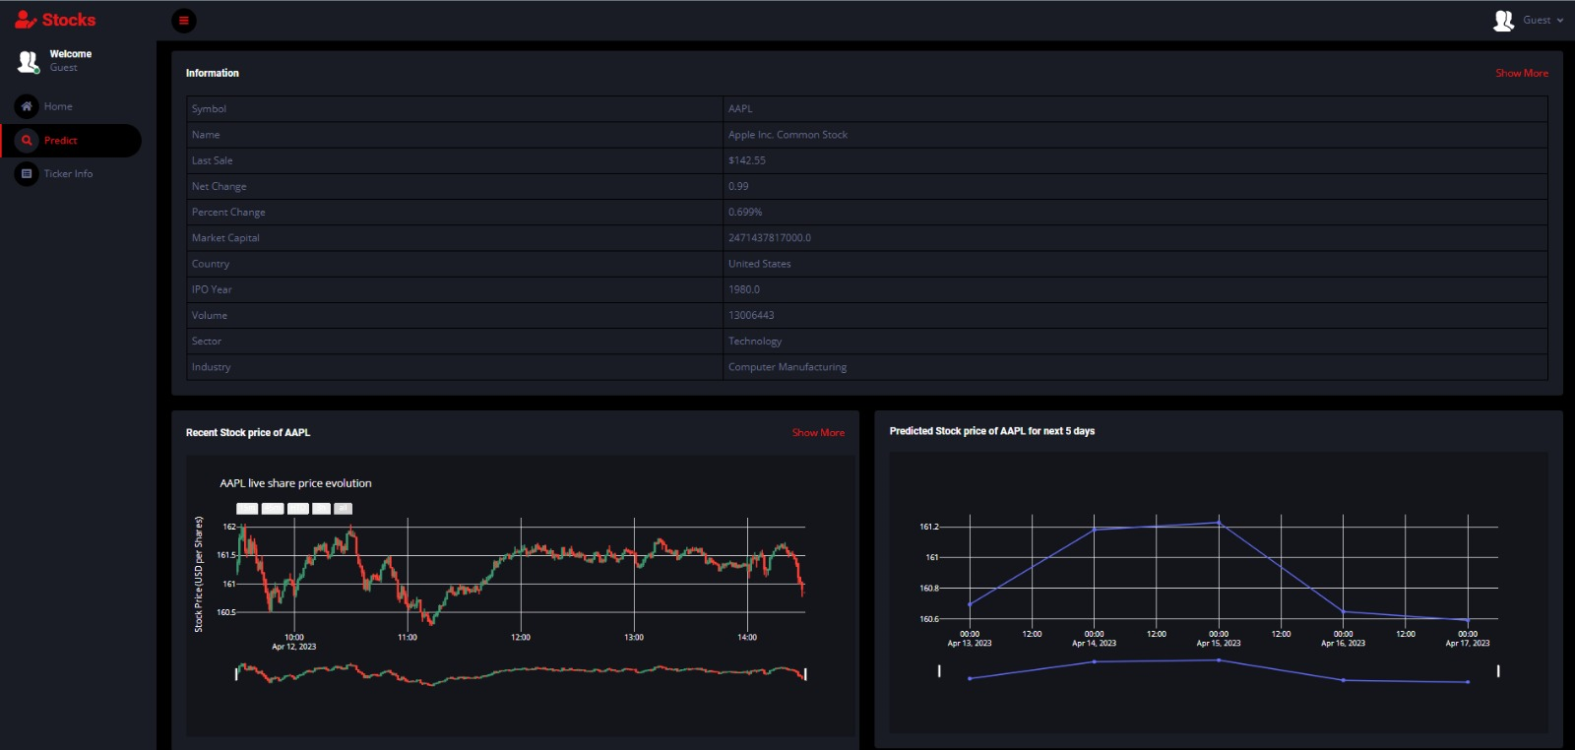
Result and Discussion

Slide 17
Conclusion and Future Scope
In conclusion, a stock prediction system using LSTM (Long Short-Term Memory) is a promising application that can help investors make informed decisions about buying and selling stocks. The use of LSTM in stock prediction has shown promising results in recent years.
The future scope of this project can include the following:
Incorporating additional features such as news sentiment analysis, can improve the accuracy of the model.
Hybrid models that combine LSTM with other machine learning algorithms such as ARIMA, Random Forest, and XGBoost can further improve prediction accuracy.

Slide 18
References
“Applications of deep learning in stock market prediction 2021.” https://www.sciencedirect.com/science/article/pii/S0957417421009441.
“Deep Learning for Stock Market Prediction - 2020.” https://www.sciencedirect.com/science/article/pii/S1877050918307828.
“Stock Closing Price Prediction using Machine Learning Techniques.” https://www.sciencedirect.com/science/article/pii/S1877050920307924.
“Stock price prediction using LSTM, RNN and CNN-sliding window model - IEEE
Conference Publication.” https://ieeexplore.ieee.org/document/8126078 (accessed Dec. 27, 2019).

Slide 19
References
B. Jeevan, E. Naresh, B. P. V. kumar, and P. Kambli, “Share Price Prediction using
Machine Learning Technique,” in 2018 3rd International Conference on Circuits,
Control, Communication and Computing (I4C), Bangalore, India, Oct. 2018.

Slide 20
Thank You...!!

